Slide 1
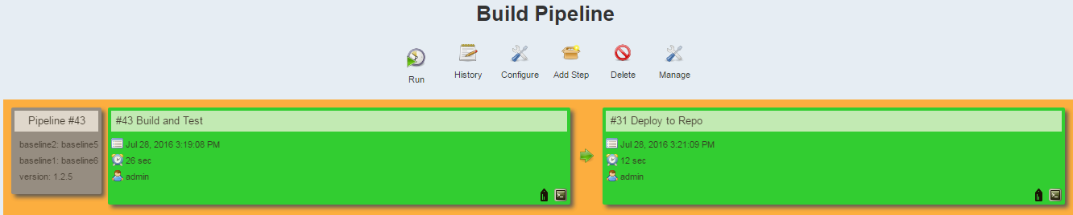
Rational Collaboration
Management
(RTC, RQM)
Jenkins
(Build Pipeline Plugin)
Nexus
6
Push to asset repository
2
Authenticate & get changes
Pull the source
Rational Team Concert
SCM Batch Utility
1
7
Download package and deploy to server
Get changes
5
4
Trigger build an test
3
Download to sandbox
Sandbox
Maven
Tomcat
Notes:
Jenkins asks for the parameters e.g. baselines and version, calls to RTC SCM Batch Utility to pull the source code. All the SCM batch files are stored in d:\test.
RTC SCM login to RTC, identify the file differences in between the supplied baselines and pipe to a file (difffiles.txt) in the sandbox, logout
Fetch the source code to the sandbox for build e.g. d:\test2
Jenkins calls to Maven to perform build and run unit test
Jenkins process the difffiles.txt, pick the compiled object of the source recorded in the difffiles.txt and package them into a deployment package e.g. sample.jar
Jenkins pushes the deployment package to Nexus under btpnWOW group, artifact SAPMoney with the version specific as one of the parameters.
Jenkins downloads the deployment package from Nexus, shuts down the tomcat, unpacks the deployment package, restarts the tomcat.

Slide 2
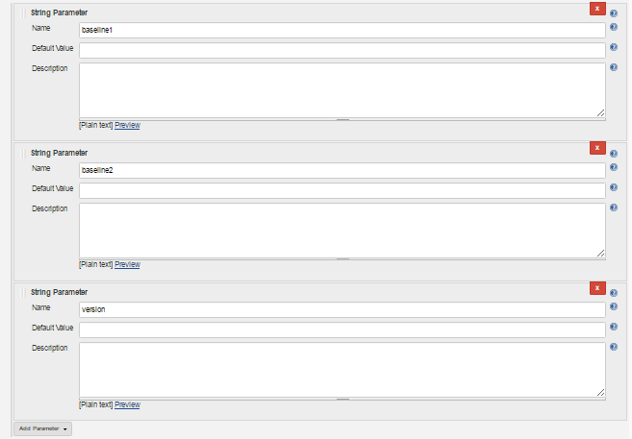
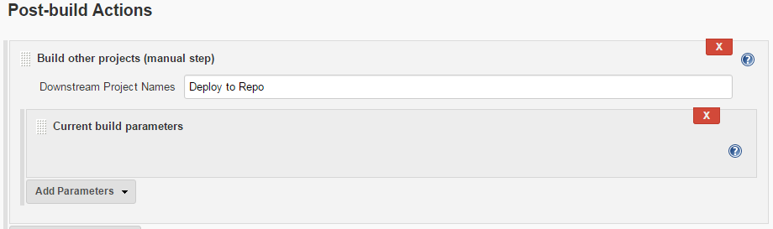
Build and Test Parameters
Build and Test Post Build Action

Slide 3
Build and Test Job Flow
d:
cd d:\test
echo Release Notes for %version% >> release-note-%version%.txt
echo ======================= >> release-note-%version%.txt
echo [Change Items] >> release-note-%version%.txt
call test.bat %baseline1% %baseline2% release-note-%version%.txt
Load Source from RTC
Clean Up
d:
cd d:\test2\demo
mvn clean
Build and Unit Test
d:
cd d:\test2\demo
mvn install
Grab changed files &
Package
d:
cd d:\test
call testFindAndZip2.bat
d:
cd d:\test
echo >> release-note-%version%.txt
echo [Asset to Repository] >> release-note-%version%.txt
echo "http://localhost:8081/nexus/content/repositories/MyRepo1/btpnWOW/SAPMoney/%version%/SAPMoney-%version%.jar" >> release-note-%version%.txt
d:
cd d:\test2\demo
mvn deploy:deploy-file -DgroupId=btpnWOW -DartifactId=SAPMoney -Dversion=%version% -DgeneratePom=false -Dpackaging=jar -DrepositoryId=MyRepo1 -D url=http://localhost:8081/nexus/content/repositories/MyRepo1/ -Dfile=target/sample.jar
Upload to Asset Repo

Slide 4
Deploy to Repo Flow
d:
cd d:\test\tempDownload
del *.* /S /Q
c:\Rational\wget\wget64 --user=admin --password=admin123 "http://localhost:8081/nexus/content/repositories/MyRepo1/btpnWOW/SAPMoney/%version%/SAPMoney-%version%.jar"
jar -xf SAPMoney-%version%.jar
c:
cd c:\Rational\tomcat\apache-tomcat-7.0.70\bin
call shutdown.bat
d:
cd d:\test\tempDownload
copy *.class C:\Rational\tomcat\apache-tomcat-7.0.70\webapps\Sample\WEB-INF\classes\com\example
c:
cd c:\Rational\tomcat\apache-tomcat-7.0.70\bin
call startup.bat
echo server started
Deploy

Slide 5
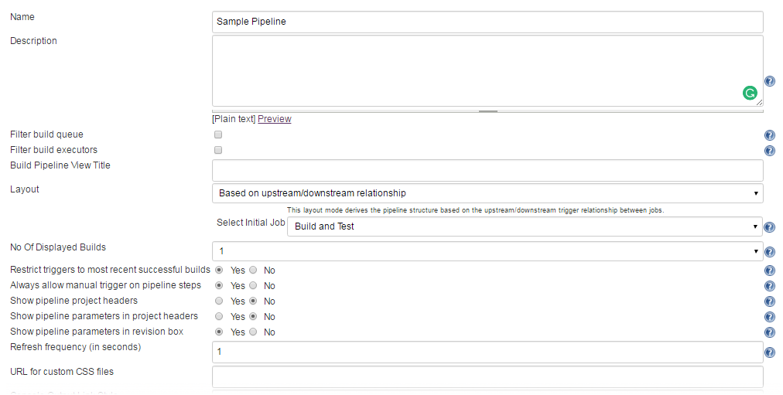
Build Pipeline Setup

